Slide 1
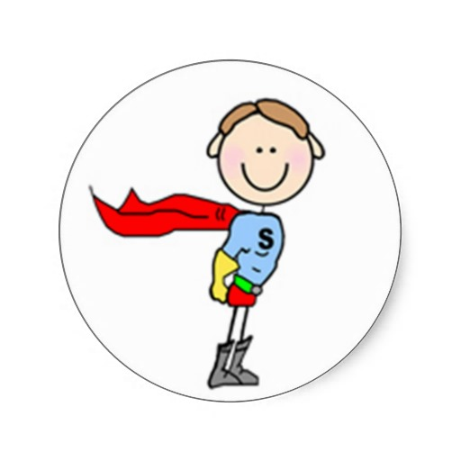
Strategies for Parents
Notes:
Russell Barkley, PhD, a leading ADHD expert, describes a "vicious cycle" that he often sees in ADHD families where a child's ADHD-related behavior is both a cause and an effect of family problems. It goes like this:
1.Parents, facing their own problems, see a child's behavior get worse.
2.Parents respond with more punishment and less encouragement.
3.This hurts the child's self-esteem and causes more behavioral problems.
4.These problems lead to more fights with the parents.
5.This reinforces the parents' view.
6.The cycle restarts
Be consistent in strategies, SMART goal:

Slide 2
STRATEGIES
Commenting
Requesting
Self-regulation
Protesting
Notes:
Self regulation: Self regulation is a natural ability that allows a person to be in control of their thoughts, feelings, impulses, and behaviors. Self regulation also allows a person to adapt and alter their responses and behaviors to cater to specific life settings. However, for some, self-regulation does not come so naturally. That is why social skills must be taught to inculcate self-regulation. I’ve broken social skills into 3 parts: requesting appropriately, protesting appropriately and commenting appropriately. Often when there is communication breakdown, chaos and disorder will take place. In teaching these 3 parts, there must be structure. Requesting…..Commenting…Protesting…Assertive
Either through formal learning formal learning, informal learning or incidental teaching. Describe each. Go from concrete to abstract. Role play to videos

Slide 3
STRATEGIES
Stop!
Think of the problem
Say how you feel
Notes:
To be able to self-regulate effectively whenever the child faces an issue, we got to practice these 3 steps and drill them in our teaching of social skills. Often we’ve heard the terms stop, think, do

Slide 4
STRATEGIES
Stop
Response instead of reacting
Think of the Problem
Take deep breaths for 3 seconds
Think of what the problem is
Say How You Feel
Tell someone what you are feeling at the moment
Verbalise what had happened to make you feel this way
Stop whatever you are doing
Notes:
Stop: When we react instead of responding, impulsive and often regrettable decisions are made. When we response it shows that we act on our cognitive and affective capacity instead of emotional outburst
Think of the problem: When we breathe, touch the tip of yr tongue on the roof of the your mouth breathe in through your nose and exhale through your mouth slowly. Then visualize the problem in your mind. Think of the sequence which led to the issue in the first place
Say how you feel: now this the hardest part. Lots of people have difficulty in expressing their feelings. When we verbalise how we feel, actually half of the emotions we feel will be released . Don’t you feel better usually you after you say how you feel? Teach the child different vocabulary for feelings. You can teach using emotions picture cards to describe different feelings

Slide 5
I-Statement Formula
Notes:
Another way to comment, protest appropriately is to be assertive. This one of the basic techniques in anger management
Instead of being aggressive, we teach the student to be assertive by using the i-statement formula. In the case of my student, instead of kicking his classmates when provoked he should tell the other student: “ I feel angry when you make fun of me in the class because I don’t like others laughing at me. What I need you to do is stop or I will report to teacher.
When you are assertive: You stand up for yourself, you avoid being passive, you avoid being aggressive, you may get your needs met more often and others may respect you.

Slide 6
Anger Reducers
Take deep breaths
Think of the consequences
Use self-talk
Count to 10
Listen to music
Put yourself in the other person’s shoes
Remove yourself from the situation
Notes:
One of the issue faced by my student in the case is his anger management due to his impulsivity. Here are some I called anger reducers to help you manage your anger:
Take deep breaths: Take a few slow deep breaths. Try to slow down your breathing. This anger reducer is most helpful when you are typically aggressive about your anger
Think of the consequences: Think and visualize what might happen if you lose control. Elaborate
Use self talk: If you are feeling like you are about to lose control, tell yourself to relax and calm down
Count to 10: Count to 10 or more before you say or do anything. This will give you extra time to get back in control
Listen to music: Music can calm us down. Turn on some fun upbeat music to lift your spirits
Put yourself in other person’s shoes: When you are angry at another person, you can reduce your anger by thinking how you would feel if you were the other person
Remove yourself from the situation: Walk away from yourself, not the other person

Slide 7
Anger Reducers
Visualize something positive
Get the facts first
Plan ahead
Participate in physical activity
Talk to a friend
Find distraction
Write to someone
Use the 20-year rule
Notes:
Visualise something positive: Picture something positive and relaxing in your mind. To calm yourself down picture your favourite place. It helps
Get the facts first: Find out what really happened from a reliable source. Ask questions and listen with an open mind, so that you understand the facts clearly
Plan ahead: If you know there is a certain situation or person that may trigger your anger, plan ahead to avoid the situation
Participate in physical activity: Physical activity can help release negative energy in a positive way. Law of conversion
Talk to a friend: sometimes talking to a friend can help you calm down by taking your mind off how angry you are
Find a distraction. This means getting involved in a positive activity to help you think about something besides your anger for a while like watching a movie or reading a book
Write to someone: Sometimes we are angry we are not comfortable talking about it. A great way to share your feelings is to write a letter to someone
Use the 20-year rule: In 20 years time will this issue make a difference in my life? Don’t sweat the small suff

Slide 8
STRATEGIES
Use positive reinforcement like praises for every effort made to motivate your child
Set realistic expectations according to the child's abilities and avoid comparison with siblings or other children
Give opportunities to expend energy through physical activity or channelling energy into acceptable venues.
Notes:
Be specific in the praises. Do not just say Gd Job but praise specifically on the actions or good behaviour of the child
Know the child’s present ability before setting the expectations. Do not compare because every child different with own unique abilities. Low self esteem
Engage in sports or exercises to channel the energy into acceptable venues

Slide 9
STRATEGIES
Remove distractions and make the environment work for him
Get the child's attention
Break up big tasks into smaller parts and give short breaks in between periods of work.
Time out when the child gets disruptive – calm corner or to his/her room
Notes:
Make sure the child’s table is cluttered free and only necessary items on the table and sit child away from any distraction in the home
Get the child's attention.
Speak in clear and concise statements that are easy to understand.
Get the child to repeat back the instructions to ensure he has heard it correctly.
Use non-verbal signals to get attention such as a tap on the shoulder or desk
Get the child to put up his hand before speaking
Remember to give breaks in between period of work
Time out should be given at a long period of time. Get the child to reflect on his behaviour after the timeout and how his actions affect himself and others

Slide 10
Example: Visual Schedule/Work Plan
Packing of School Bag
Schedule placed on the room where child places his bag:
Have you sorted the books/ files necessary for tomorrow ?
Is your pencil case with you?
Place the files in the bag.
Place books into the bag.
Place pencil case into the bag.
Finish.
Parent ticks off each section upon completion
End of schedule must be marked by ‘Finish’
Notes:
Schedules help to get the child to be organised. To reduce anxiety, we need to promote predictability. It will also help to monitor the child’s sequence of activities and to break up the task into smaller parts

Slide 11
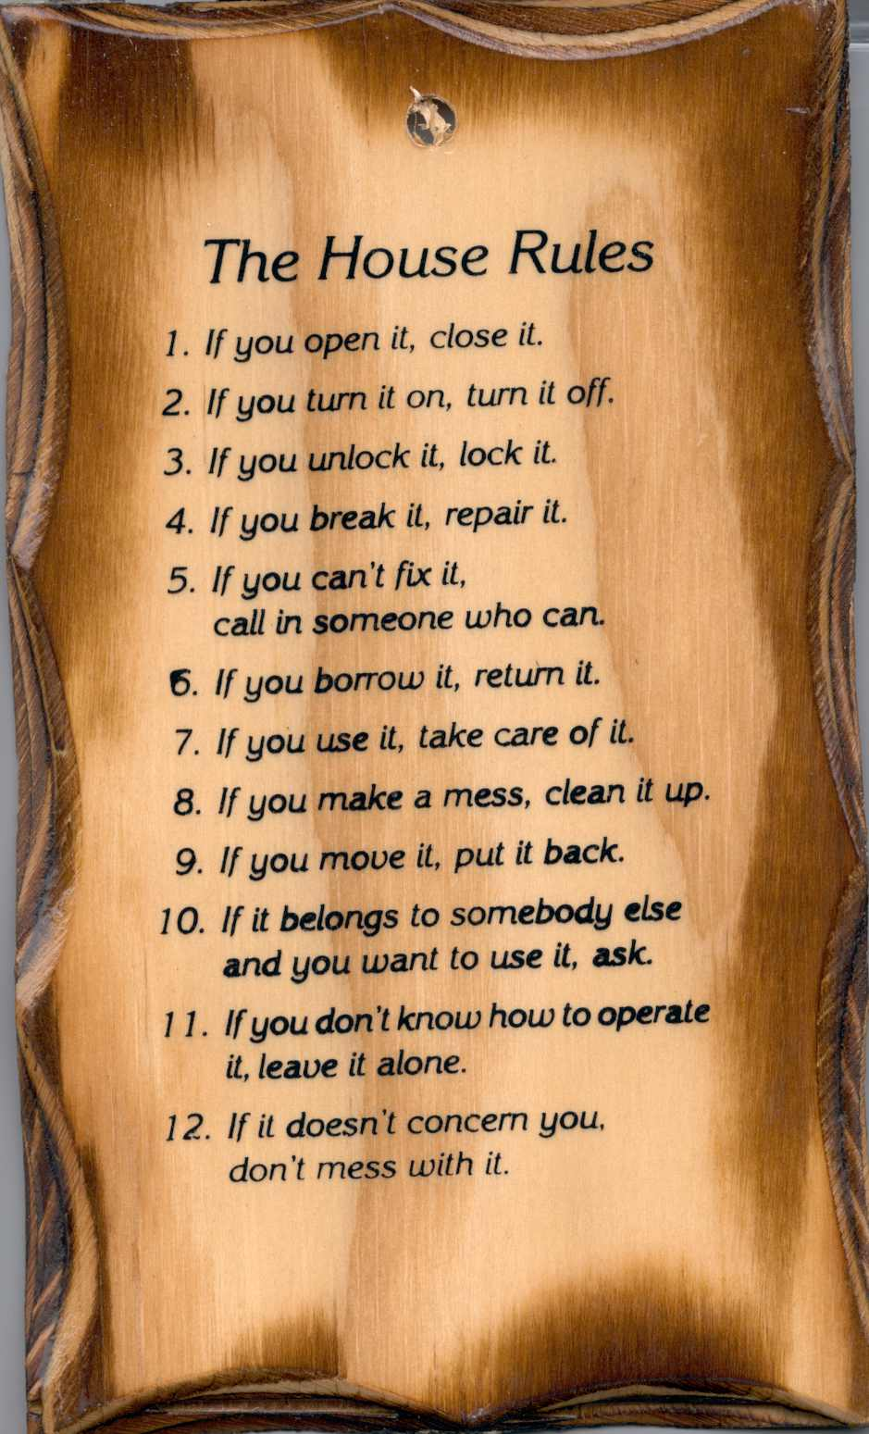
Routines
Notes:
Routines are very useful and important in the sense that if child is not given a routine, he will develop a negative routine on his own. Routines must be reinforced consistently. Consistency is the key. Remind and correct the child until he is able to perform the routine independently. Everybody in the house should reinforce the routines together for consistency and the routine to work.

